Slide 1
Principles of Evolution and Phylogenetics
Primary Source: Evolution 101
http://evolution.berkeley.edu/evolibrary/article/evo_01
developed by the
University of California Museum of Paleontology
and the
National Center for Science Education.
Notes:
***Complete Question 1 on the Supplemental Worksheet***

Slide 2
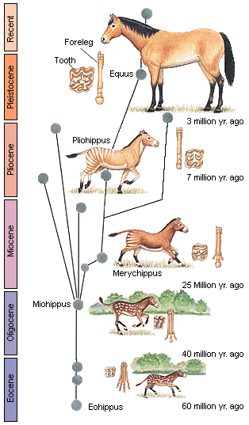
Evolution: descent with modification
A phylogeny or phylogenetic tree is a diagram representing the ancestral relationships of species.
https://the-evolution-of-horse.weebly.com/information.html
Notes:
https://the-evolution-of-horse.weebly.com/information.html
Evolution is the process of descent with modification.
Example, horse evolution. Eohippus had offspring slightly different from the parents. Differences are passed on, and after enough differences accumulate, they are considered a different species – leading to modern horses.
This is not a linear process.
Several divergence points with multiple species alive at the same time, but many lineages went extinct.
This diagram is a phylogeny, or phylogenetic tree
Shows evolutionary relationships between organisms and the amount of time since each species diverged from a common ancestor.

Slide 3
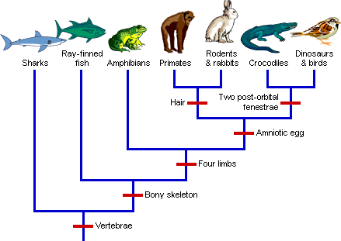
Evolution
Organisms living today share a common ancestry
A phylogeny is a hypothesis to explain the origin of species, based on all data currently available.
A clade is a group that includes a common ancestor and all of its descendent species.
Notes:
See points on slide
This is a type of phylogenetic tree called a “cladogram”. Shows which organisms appear to be most closely related to each other, based on how many characteristics they share.
Does not include a time scale like many other phylogenetic trees.
This cladogram shows how different species of vertebrates are related to each other.
All of the species in this clade have a spine comprised of vertebrae, because the last common ancestor of this clade also had vertebrae.
A characteristic that is shared due to common ancestry is called an “ancestral” characteristic.
Example: Primates and rabbits are likely closely related because they have hair. Their common ancestor likely had hair.

Slide 4
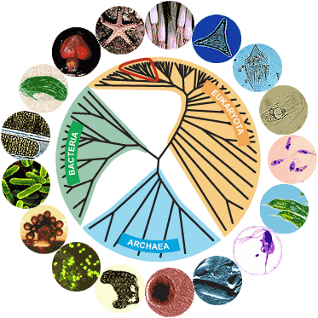
Phylogeny
The phylogeny at the right shows the relationship of all of the organisms on earth, starting with the three domains of life.
Our understanding of the evolutionary relationships between species may change when new data become available.
Notes:
Adl et al. 2019. Revisions to the classification, nomenclature, and diversity of eukaryotes. J. Eukaryot. Microbiol. 66: 4-119
This is a different type of phylogenetic diagram, where the last common ancestor is at the center of the circle and all the modern organisms are shown at the edges of the circle.
The branching structure is the same, with the Last Universal Common Ancestor at the middle.
Note that this last universal common ancestor was not necessarily the first life to exist on earth, but rather the last common ancestor of all life that remains today.
The phylogeny pictured here shows a hypothesis explaining the relatedness of all life on earth. As we gain more phenotypic and genotypic data, our hypotheses (and phylogenies) change.
Example: scientists used to think Euglenozoa and Metamonada formed a single clade that they called “Excavata”. However new genomic data suggests they aren’t closely related.
These kinds of taxonomic revisions happen frequently, especially in groups of organisms that haven’t been studied as intensely.

Slide 5
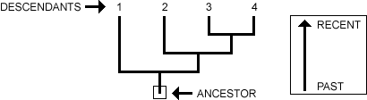
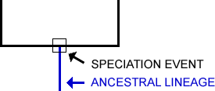
How to Interpret a Phylogeny
The root is a common ancestor and the tips of the branches represent species descended from that ancestor
Branch points in the phylogeny represent speciation events, i.e. when two or more species arise from an ancestral species
Notes:
See slide

Slide 6
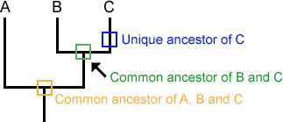
Phylogenies show common ancestry
Notes:
See slide.

Slide 7
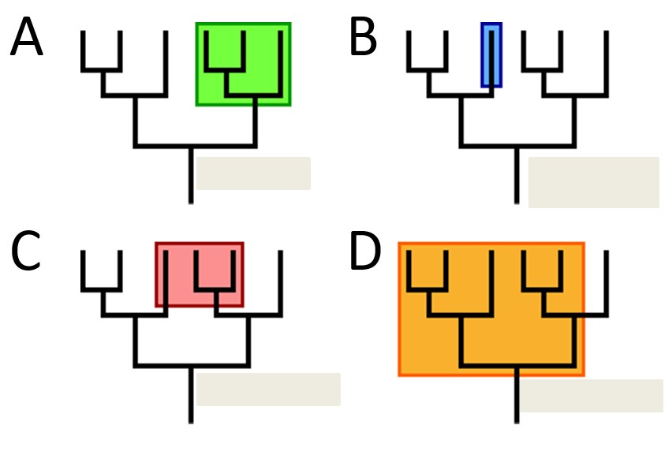
Clades
A clade is a group that includes a common ancestor and all of its descendent species.
Of the following groups highlighted in colored boxes, which one(s) would be considered a clade?
Notes:
***Question 2 on Supplemental Worksheet***

Slide 8
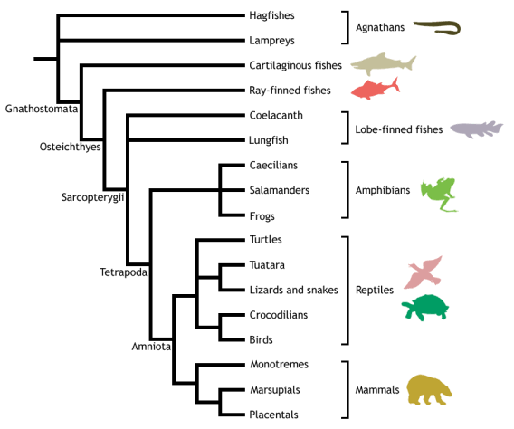
Clades
Examine the vertebrate cladogram to the right.
When people refer to reptiles, they are commonly referring to non-avian reptiles (all reptiles but birds). Is it appropriate to refer to non-avian reptiles as a clade?
http://fsc.fernbank.edu/STT/VertBio/vertebrate_classes.htm
Notes:
http://fsc.fernbank.edu/STT/VertBio/vertebrate_classes.htm
***Question 3 on Supplemental Worksheet***

Slide 9
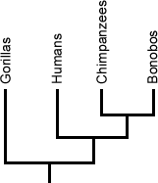
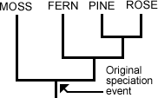
Phylogenies are trees, not ladders
Sometimes people misinterpret evolutionary theory to mean that a currently living species descended from another currently living species.
Vascular plants such as pine (gymnosperm) and rose (angiosperm) did not descend from moss. Rather, the plants above share a common ancestor. Mosses are simple plants and it is likely that fewer chances have occurred in their lineage than in the angiosperm lineage since these two linages split.
Humans did not descend from chimps. Humans and chimps share a recent common ancestor.
Notes:
A common misconception about evolutionary theory is the false idea that currently living species descended from other currently living species.
Pine and Rose did not descend from Moss (or vice versa). They share a common ancestor.
Humans did not descend from Chimpanzees and Bonobos (or vice versa). They share a common ancestor.
You can think of us like distant cousins, not like parent and offspring.

Slide 10
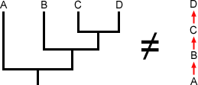
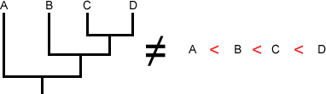
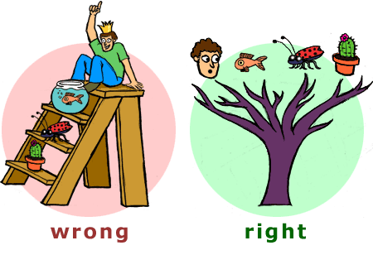
Phylogenies are trees, not ladders
The species at the ends of the branches are currently living species that descended from a common ancestor.
Notes:
Cladograms highlight species of interest, not ancestors. Species A did not evolve into Species B, C, and D. Instead, they all share common ancestry.
Another common misconception in interpreting phylogenies is the false idea that one species is "better" or "more evolved" than others.
Species D is not "better" than Species A, B, or C. Likewise, humans are not "better" than other species.
Each species alive today is just as "evolved" as everything else.

Slide 11
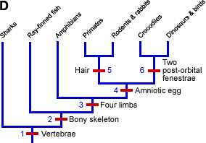
The Data Used to Build Phylogenies: Shared Derived Characters
Derived: not present in the ancestral form.
Notes:
Phylogenies are based on shared derived characters.
These characteristics could be phenotypic (e.g. hair) or genotypic (e.g. adenine base instead of guanine base in DNA).
In the cladogram here, each trait listed by a red line is a derived character. For example, a common ancestor of primates, rodents, and rabbits developed hair and passed it to its descendants.
The more derived characters two groups have in common, the more likely they are to be related.
All groups here have vertebrae, so it’s at the base of the tree
Only Crocs, Dinos, and Birds have two post-orbital fenestrae, so it’s at their last common ancestor.
When a trait is gained or lost, it’s called a “transition” in the cladogram.

Slide 12
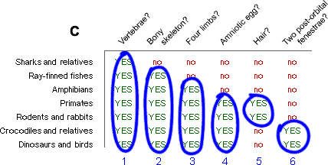
Building a Phylogenetic Tree
Organisms with more shared derived characters are more closely related
Notes:
First, we compile info about the characters possessed by each species.
More shared derived characters = more likely to be related.

Slide 13
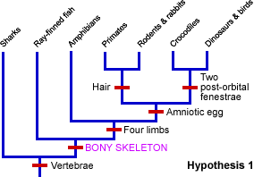
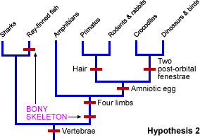
Use the Principle of Parsimony in Building a Phylogenetic Tree
It is possible to make more than one tree for a group of species.
Build the one that requires characters to arise the fewest times.
Hypothesis 1 is the most parsimonious because the character of bony skeleton only has to arise once.
Notes:
Principle of parsimony: Always use the simplest explanation.
Simpler hypotheses are usually closer to the truth than unnecessarily complex hypotheses.
Sometimes called “Occam’s razor”. Promoted by the philosopher Occam who encouraged his students to “shave away unnecessary assumptions”.
It is possible to make many cladograms (hypotheses) for a set of species. But some require more transitions than others: more complex and less likely to be true.
We try to build cladograms with the fewest number of transitions possible (like Hypothesis 1 here).

Slide 14
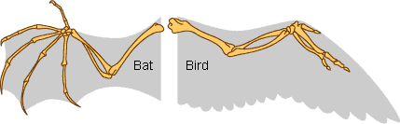
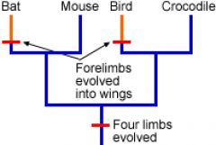
Homologous vs. Analogous
Homologous: a character shared by two species that inherited it from a common ancestor
Analogous (homoplasy): a character shared by two species that evolved independently in their respective ancestries
Both birds and bats have wings, but evidence indicates that they each evolved them separately from non-winged ancestors
no wings
no wings
Notes:
See slide.
Up until this point, we have mostly been talking about homologous traits.
Analogous traits are shared by two species, but evolved independently.
Example, both birds and bats have wings, but based on other phenotypic and genotypic data, we know that they actually evolved wings separately. Thus on an accurate cladogram, wings would be added twice.
Note: while wings are analogous, the forearm bones themselves are actually homologous traits that were inherited from a common ancestor.
***Complete Question 4 on Supplemental Worksheet***

